Slide 1
How to Find Age Appropriate and Accurate Information
A Presentation Given by zack edwards creator of Historical Conquest and HuntThePast.com

Slide 2
Why is History Important:
Santayana once wrote: "Progress, far from consisting in change, depends on retentiveness. Those who cannot remember the past are condemned to repeat it.“
No civilization can grow without a knowledge of their, and other civilization’s, past.

Slide 3
History of Historical Education
Before Printing Press: Story Telling AND Source Documents ( journals, artifacts, documents written by hand)
After the Printing Press: Books written from Source Documents, (public records, newspapers, etc) these were chroniclers' and historians' interpretations of past events, and the like.
Marxist Historiography: Teaching with an end in mind, guiding students to a conclusion. Oppressed vs Oppressors. Brother in Law’s Experience getting his teaching degree.
1980’s Research – Memorization is not the way to learn history, but teaching meaningful concepts.
PRESENT DAY – Finding more reliable materials.
HOW HISTORY WAS TAUGHT:
BEFORE PRINTING PRESS
AFTER PRINTING PRESS
MARXIST HISTIOREOGRAPHY
1980’S RESEARCH
PRESENT

Slide 4
Seven different learning styles
PAST: In the past we had one way to learn history: Mixture of Reading, Lectures, Memorization, and Tests
PRESENT: There are seven different learning styles that need to be understood. (https://www.learning-styles-online.com/overview/)
Visual (Spatial)
Aural (Auditory-Musical)
Verbal (Linguistic)
Physical (Kinesthetic)
Logical (Mathematical)
Social (Interpersonal)
Solitary (Intrapersonal)

Slide 5
HOW HISTORY IS WRITTEN
SOURCE DOCUMENTS: Artifacts, journals, hand written documents.
TRANSLATORS – All depends on the interpretation
BOOKS WRITTEN FROM TRANSLATIONS – Bias may be gained from the translation.
BOOKS WRITTEN FROM BOOKS – Inaccuracies are multiplied with each book.
TELEVISION/INTERNET – Anyone can write it.
SOCIAL MEDIA – Not everyone is a historian.
WORD OF MOUTH – Memories are inaccurate.

Slide 6
UNRELIABLE RESOURCES:
WIKIPEDIA – History told by anyone;
HISTORY WEBSITES – Add fiction to their history to ENTERTAIN, to buy something;
YOUTUBE – Anyone can spout what can only be assumed as facts, without sources;
SOCIAL MEDIA – Not everyone is a historian even though they may say they are;
WORD OF MOUTH – Things are forgotten and rewritten in a person’s memory;
TEXTBOOKS (Some) - Books that source other books written about subjects

Slide 7
We are not makers of history. ...
Martin Luther King Jr.
There is only one history, whether you are in the United States or Britain, the American Revolution happened one way. Germany or the Jewish Community, there was only one true history.

Slide 8
Revisionist history
COST: Revisionist history can be taught as Marx, teaching with a means in mind and leading your students.
BENEFIT: George Washington cutting down a cherry tree was false and that has been remitted from textbooks.

Slide 9
ADVISE TO FIND ACCURATE RESOURCES: SOURCES
Make sure those that are teaching your students:
Cite their sources – find out where those sources come from;
The number of sources doesn’t matter as much as quality;
Use accurate sources, the closer to the source document the better.

Slide 10
ADVISE TO FIND ACCURATE RESOURCES: biases
Make sure those that are teaching your students:
Don’t have a bias one way or another.
If they are to have a bias, make sure they stand for your values
Look at their funding if you can.
i. Government Funding ii.

Slide 11
ADVISE TO FIND ACCURATE RESOURCES: teaching style
Make sure those that are teaching your students:
Have the right teaching style for your child;
Teach in many different learning styles for all students. There are 7;
These include: videos, activities, hands-on experience, audio, etc
Textbooks only have a 10-20% retention rate, while educational games are 70-80% and teaching a subject to others are up to 90%

Slide 12
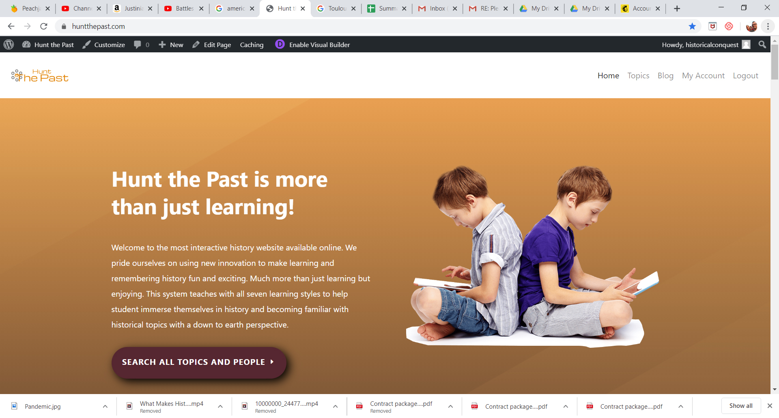
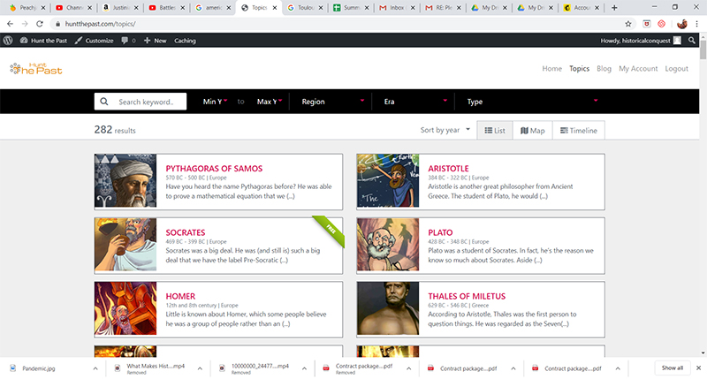
Welcome to www.HuntThePast.com

